Slide 1
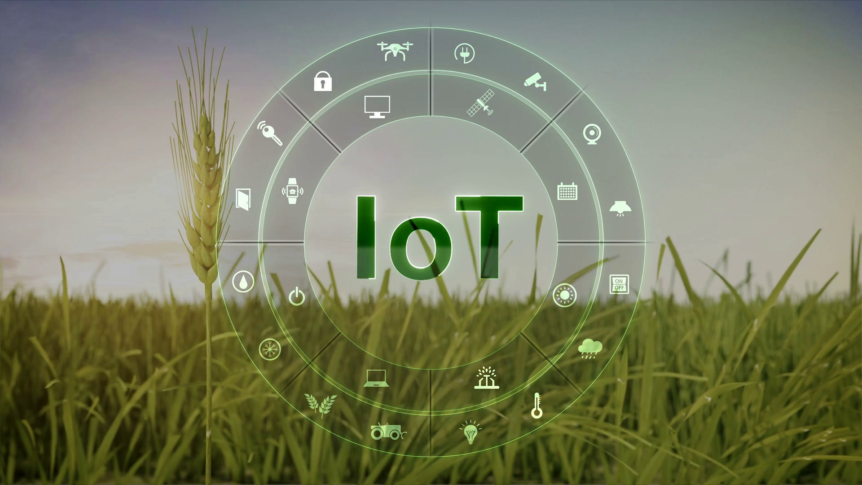
Smart Irrigation System
.

Slide 2
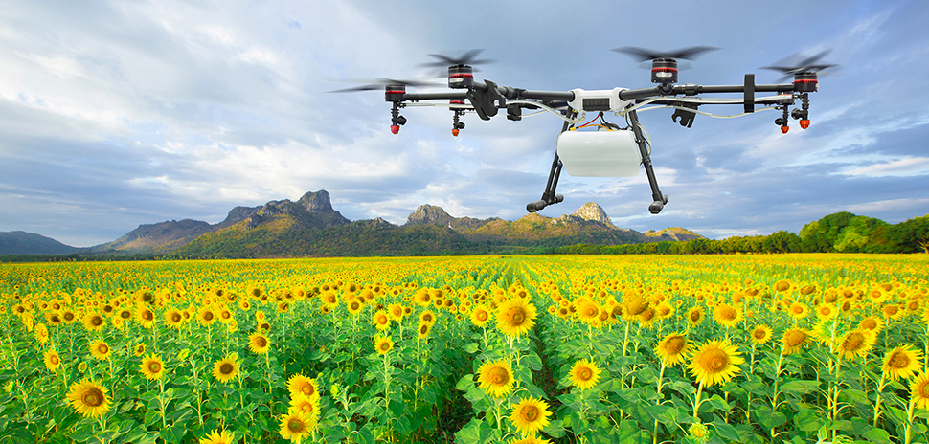
Points to be discussed :
Introduction
Objective
System Components
Working
Working Diagram
ER Diagram
Advantages
Conclusion
References

Slide 3
Introduction :
Agriculture plays a vital role in India’s economy and all around the world.
54.6% of the India’a population is engaged in agriculture and allied activities and it contributes 17% to county’s GDP.
Nowadays , its important to increase the crop yields food grain production as the matter of fact the world population is increasing day-by-day.
Agricultural system/methodologies, technologies directly affect the production of crops and quality.
Technology can bring a new revolution in the agriculture pattern and output.
The revolution of IOT and existing internet, embedded devices, sensors and smart phones could solve the problems of collecting samples.

Slide 4
Objective :
In this project we are going to propose a Smart Irrigation System with the use of Internet Of Things.
This system will be responsible for irrigation of large farms, watering roadside greeneries/ gardens etc automatically according to the volumetric humidity of the soil (Detected by the soil moisture sensor).
This system will also collect Agricultural data such as field geo-location, temperatue ,humidity and other soil properties.
And the collected data will be used for analysis using Data-Mining, prediction and hazard prevention using regression analysis.
The proposed model would solve the problems of human limitation and also reduce human labour.

Slide 5
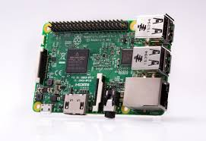
System Components :
Raspberry Pi 3B : It is a small powerful and light weight computer and It comes with a 1.2GHz quad-core ARM Cortex-A53 and 1GB LPDDR2 RAM. It's no slouch, especially compared to earlier Pi models, but it's also not nearly as powerful as your modern, high-end smartphone.

Slide 6
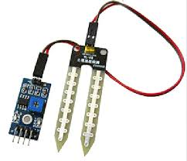
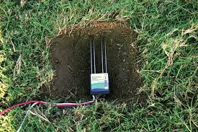
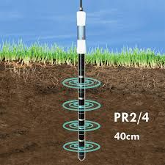
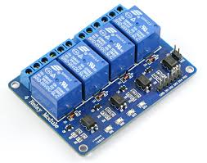
Soil Moisture Sensor : This sensor measures the volumetric water content in the soil. This sensor measure the volumetric water content indirectly by using some other property of the soil such as electrical resistance, dielectric constant, or interaction with neutrons as a proxy for the moisture content.
Relay : A relay is a switching device as it works to isolate or change the state of an electric circuit from one state to another.

Slide 7
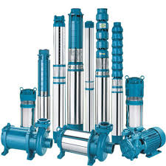
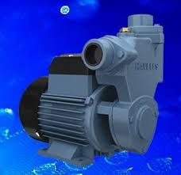
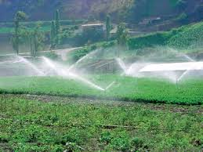
Water Pump/Motor : It will be used to irrigate the farm and it will be controlled via Raspberry Pi.
LAN Cable : To connect raspberry pi with laptop.
USB Cable : To power Raspberry Pi
Jumper Wires : To connect raspberry pi to sensors, relay and also control them.

Slide 8
Working :
System uses sensors to measure the volumetric water content of the soil and according to the requirement of the crops/plants water is given to the crops.
Outputs of the system are analog in nature and this system uses Raspberry Pi 3b as a central processing unit to control all the activities.
Relay switch has been used to control the motor .
The least moisture content is set to be 28% and if moisture is that low then system will start the motor until the moisture content is equal to 52%.

Slide 9
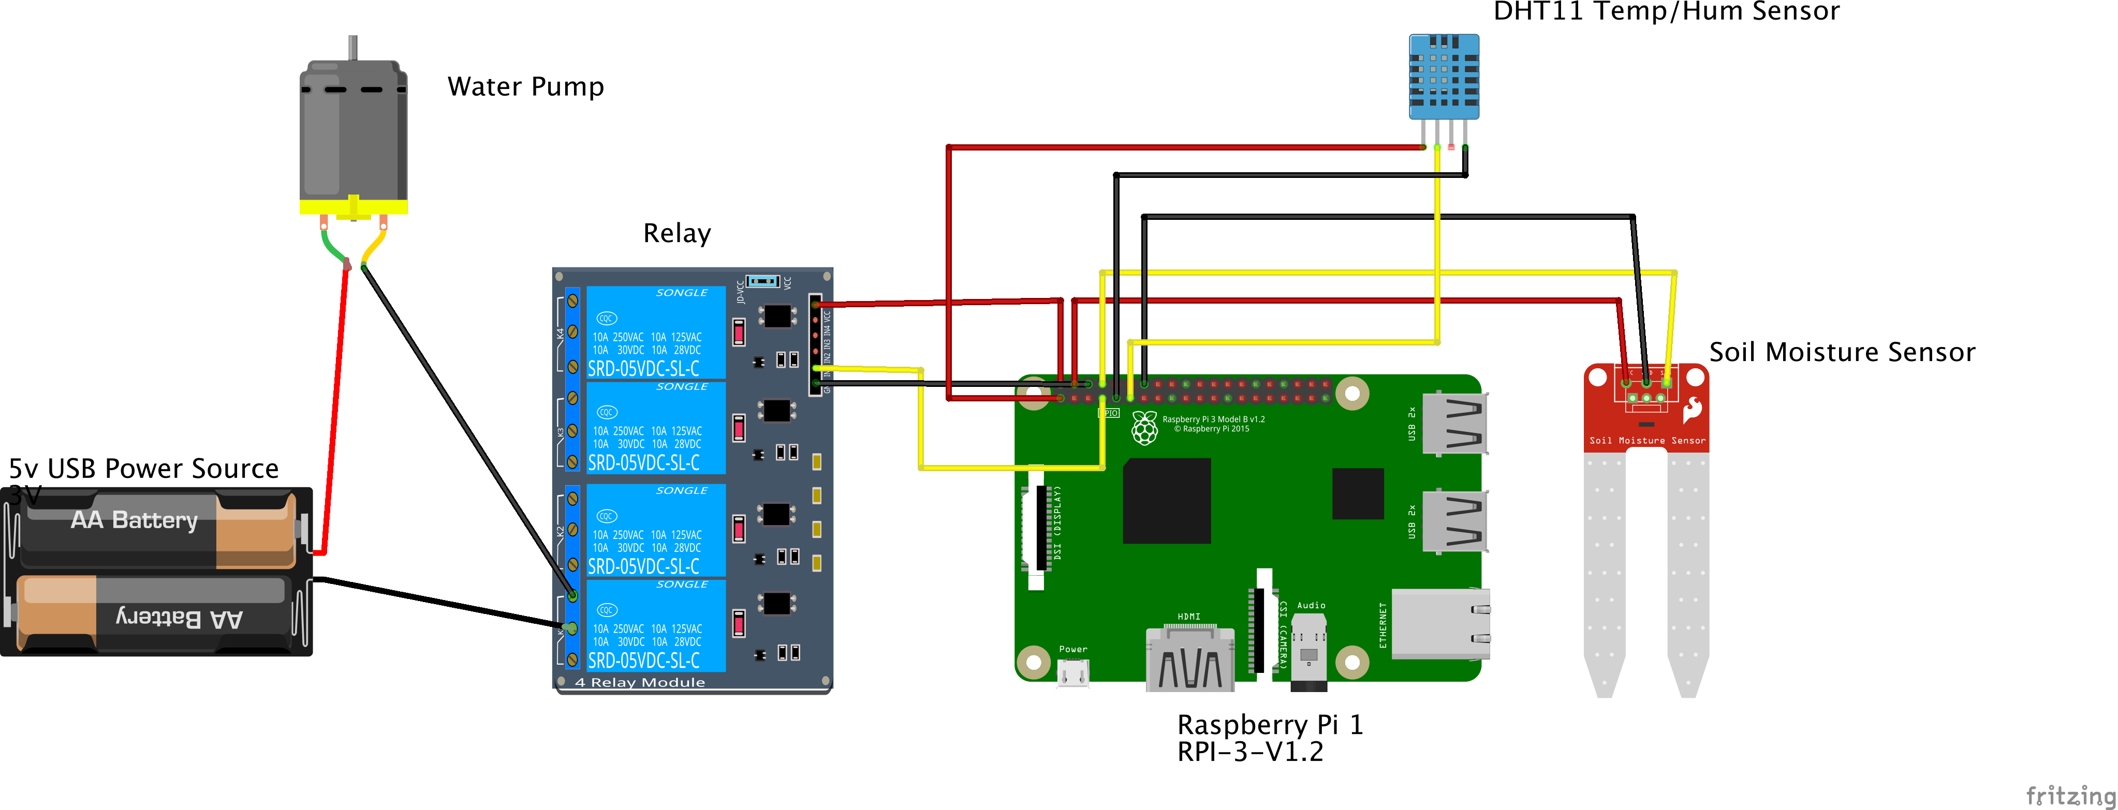
Working Diagram:
Workflow -

Slide 10
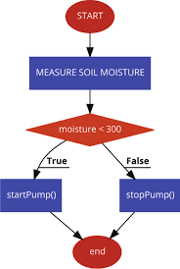
Entity Relation Diagram:
.

Slide 11
Advantages :
Increase in productivity
Low cost product
Reduced human effort
Reduce soil erosion and nutrient leaching
Effective
Reduce water consumption
Flexible

Slide 12
Conclusion :
The smart irrigation system is feasible and cost effective.
This system allows cultivation in places with water scarcity thereby improving sustainability.
This system is also flexible to use with different kinds of sensors as well as pumps,sprinkler systems simultaneously.
It proves that use of water can be diminished in farming.
It can also be used to maintain roadside greeneries, public gardens, playgrounds, botanical gardens etc.

Slide 13
References :
Github
www.iijert.org
Youtube.com
www.edgefx.in
www.stevens.com
https://www.pubnub.com/blog/smart-automated-iot-plant-irrigation-system-raspberry-pi-pubnub/

Slide 14
Thank you

